Slide 1
Adaptations
Monday 17th June
You are going to make an engaging, scientific and captivating presentation about how animals and plants are adapted to their environment.
On each slide there is a cue for what needs to be included. If you complete all the slides, you can add your own!
The format is completely up to you!
At the very end, add your animations.
At the very very end, email it back to me at j.docherty@harrisgreenwich.org.uk.

Slide 2
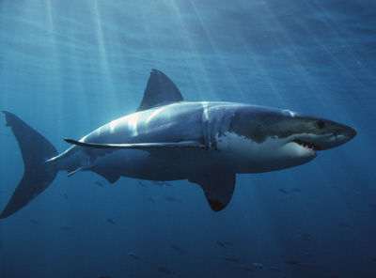
Example: Sharks
Ideas: Get a picture of the animal, then annotate the picture to show how the animal is adapted to its environment.
Ext: Explain how the adaptations give the shark benefits!
Streamlined body so that they can swim faster than prey and catch more food.
Liver with oil lighter than water for added buoyancy.
Gills to absorb oxygen from the water and release carbon dioxide back in.
Extremely large teeth, in many rows. The teeth point backwards, and are constantly replaced.
Powerful tail muscles to swim fast through the water.
Powerful jaw muscles to trap and crush prey.
Rough skin shaped for added streamlining so that sharks can swim faster than prey through the water.

Slide 3
Polar bears
Ideas: Get a picture of the animal, then annotate the picture to show how the animal is adapted to its environment.
Ext: Explain how the adaptations give the shark benefits!

Slide 4
Cactus
Ideas: Get a picture of the animal, then annotate the picture to show how the animal is adapted to its environment.
Ext: Explain how the adaptations give the shark benefits!

Slide 5
Musk Ox
Ideas: Get a picture of the animal, then annotate the picture to show how the animal is adapted to its environment.
Ext: Explain how the adaptations give the shark benefits!

Slide 6
Your choice! (Pick any other animal and describe its adaptations)
Ideas:
The Texas Horned Lizard’s Blood Shooting Defense
The Hippopotamus’ Blood Sweat
The Komodo Dragon’s Filthy, Disgusting Mouth
The Pistol Shrimp’s Shooting Claw
The Anglerfish’s Extreme Sexual Dimorphism
The Spotted Hyena’s Strange Sex Organs

Slide 7
Make up your own animal or plant…how is it adapted for its environment?

